Slide 1
CSE 453
High Performance Database Systems
Course Teacher : Md Tarikul Islam Papon

Slide 2
Dynamo: Amazon’s Highly Available Key-value Store

Slide 3

The Problem
Serves 1.1 million requests per second
Has tons of services

Slide 4
The Problem
Tens of thousands of servers
Many data centers across the world
Small and large components fail continuously

Slide 5
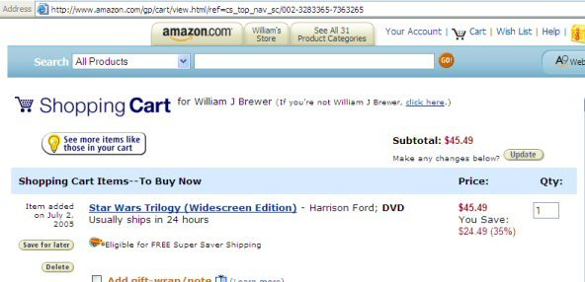
Motivation
Amazon uses a highly decentralized, loosely coupled, service oriented architecture consisting of hundreds of services.

Slide 6
Motivation
Amazon’s platform has a very diverse set of applications with different storage requirements.
There are many services on Amazon’s platform that only need primary-key access to a data store.

Slide 7
Motivation
Build a distributed storage system that is:
Highly available (sacrifice consistency)
Highly reliable
Highly scalable
Flexible
Simple key-value
Guarantee Service Level Agreements (SLA)

Slide 8
Amazon S3
Amazon S3 (Simple Storage Service) is an online file storage web service offered by Amazon Web Services.
Launched in 2006

Slide 9
Amazon Services
Stateless
Stateful
Not ideal to use RDBMS
typically choose consistency over availability

Slide 10
What Dynamo Offers
Dynamo uses a synthesis of well known techniques to achieve scalability and high availability.
Consistency is facilitated by object versioning.
Decentralized replica synchronization protocol.

Slide 11
What Dynamo Offers
A gossip based distributed failure detection.
A completely decentralized system with minimal need for manual administration
A simple key/value interface
Efficient in its resource usage

Slide 12
System Assumptions and Requirements
Query Model
Simple read and write operations to a data item that is uniquely identified by a key.
targeted applications - store objects that are relatively small (usually less than 1 MB)

Slide 13
System Assumptions and Requirements
ACID Properties
Dynamo targets applications that operate with weaker consistency (the “C” in ACID) if this results in high availability.

Slide 14
System Assumptions and Requirements
Efficiency
latency requirements which are in general measured at the 99.9th percentile of the distribution
The tradeoffs are in performance, cost efficiency, availability, and durability guarantees.

Slide 15
System Assumptions and Requirements
Other Assumptions
Operation environment is assumed to be non-hostile
No security related requirements such as authentication and authorization.

Slide 16
Service Level Agreements (SLA)
Application can deliver its functionality in bounded time
Example
Provide a response within 300ms for 99.9% of its requests for a peak client load of 500 requests per second.

Slide 17
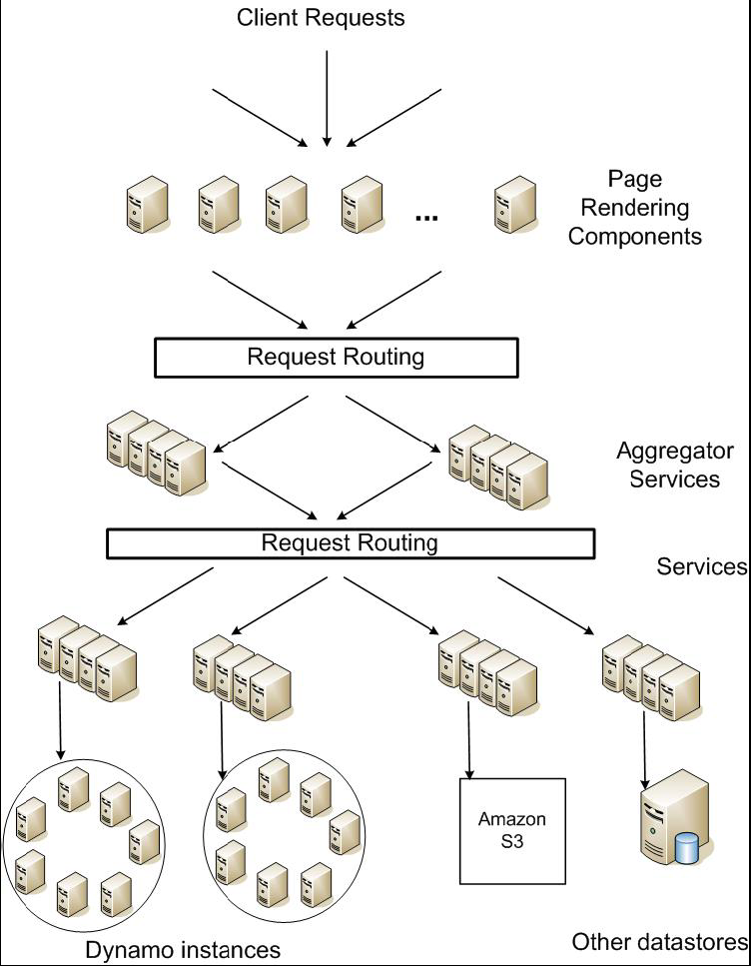
Service-oriented Architecture
Every dependency in the platform needs to deliver its functionality with even tighter bounds.

Slide 18
Why 99.9th percentile?
Typical Practice
average
median
expected variance.
Not good enough if the goal is to build a system where all customers have a good experience, rather than just the majority.

Slide 19
Design Consideration
Sacrifice strong consistency for availability
Eventually consistent
Conflict resolution
when to resolve them
who resolves them

Slide 20
Design Consideration
When to resolve them
Dynamo targets the design space of an “always writeable” data store
Conflict resolution is executed during read instead of write

Slide 21
Design Consideration
Who resolves them
Data store
last write wins
The application

Slide 22
Design Consideration
Incremental scalability
Symmetry
Decentralization
Heterogeneity

Slide 23
Related Work
Peer to Peer Systems
Freenet and Gnutella
Pastry and Chord
Oceanstore and PAST

Slide 24
Related Work
Distributed File Systems and Databases
Coda, Ficus and Bayou
The Farsite system
Google File System
FAB and Antiquity
Bigtable

Slide 25
System Architecture
System Interface
Partitioning
Replication
Versioning
High availability for writes
Handling failure(temporary and permanent)
Scaling

Slide 26
System Interface
Key
Object
Two operations:
put(key, context, object)
writes it to disk based on the context

Slide 27
System Interface
Key
Object
Two operations:
get(key)
returns list of objects with a context
context encodes system metadata along with version

Slide 28
Partitioning Algorithm
Consistent Hashing
Problem of basic Hashing
Hash(key) → 963%3 = 0
Node
0
Node
1
Node
2
key

Slide 29
Partitioning Algorithm
Consistent Hashing
Problem of basic Hashing
Hash(key) → 963%4 = 1
404: No key found!!!
Node
0
Node
1
Node
2
Node
3
key

Slide 30
Consistent Hashing
What is Consistent Hashing?
N0
Assign Nodes in random positions
Each Node is responsible for the region between itself and its predecessor
N1
N2

Slide 31
Problems of Consistent Hashing
Random position assignment of each node on the ring leads to non-uniform data and load distribution.
N0
N2
N1

Slide 32
Solution
Virtual Nodes
Each node can be responsible for more than one virtual node.
N0
N1
N2
N0
N1
N2
N2
N0
N1

Slide 33
Data Replication
Each data item is replicated at N hosts.
preference list: The list of nodes that is responsible for storing a particular key.

Slide 34
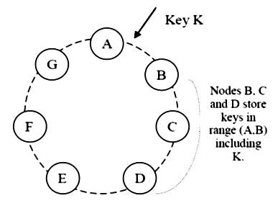
Data Replication
Each Node is responsible for the region between itself and its N^{th} predecessor.

Slide 35
Data Versioning
Eventual consistency
A put() call may return to its caller before the update has been applied at all the replicas.
A get() call may return many versions of the same object.

Slide 36
Data Versioning
Certain operations can neither be forgotten or rejected.

Slide 37
Vector Clock
A vector clock is effectively a list of(node, counter) pairs
One vector clock is associated with every version of every object.

Slide 38
Vector Clock- Example
write handled by Sx
D1([Sx, 1])
write handled by Sx
D2([Sx, 2])
write handled by Sy
write handled by Sz
D3([Sx, 2], [Sy, 1])
D4 ([Sx, 2], [Sz, 1])
reconciled and written by Sx
D5 ([Sx, 3], [Sy, 1], [Sz, 1])

Slide 39
Execution of get () and put () operations
Two strategies to select a node:
Route its request through a generic load balancer that will select a node based on load information.
Advantage: the client does not have to link any code specific to Dynamo in its application

Slide 40
Execution of get () and put () operations
Two strategies to select a node:
Use a partition-aware client library that routes requests directly to the appropriate coordinator nodes.
Advantage: can achieve lower latency because it skips a potential forwarding step.

Slide 41
Execution of get () and put () operations
A node handling a read or write operation is known as the coordinator.
Read and write operations involve the first N nodes in the preference list.

Slide 42
Execution of get () and put () operations
R/W is the minimum number of nodes that must participate in a successful read/write operation.
Setting R + W > N yields a quorum-like system.

Slide 43
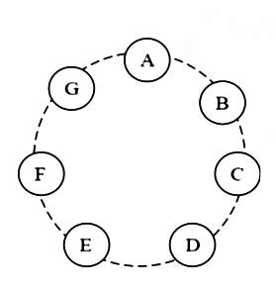
Execution of get () and put () operations
Request for a get comes here.
N = 3
R = 2
W = 2
Coordinator routes is to other nodes in the preference list
Preference List : [B, C, D]

Slide 44
Execution of get () and put () operations
N = 3
R = 2
W = 2
Coordinator receives its own and D’s data. Perform necessary version reconciliation
Preference List : [B, C, D]

Slide 45
State Machine for Read
A read operation implements the following state machine:
send read requests to the nodes
wait for minimum number of required responses
if too few replies were received within a given time bound, fail the request
otherwise gather all the data versions and determine the ones to be returned
if versioning is enabled, perform syntactic reconciliation

Slide 46
State Machine for Write
Write requests are coordinated by one of the top N nodes in the preference list.
Since each write usually follows a read operation, the coordinator for a write is chosen to be the node that replied fastest to the previous read operation.
“read-your-writes” consistency

Slide 47
N, R and W
Client applications can tune the values of N, R and W to achieve their desired levels of performance, availability and durability.
If W is set to 1, then the system will never reject a write request as long as there is at least one node in the system that can successfully process a write request

Slide 48
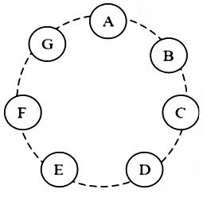
Handling Failures: Hinted Handoff
Read and write operations involve the first N healthy nodes in the preference list.
Assume N = 3. When A is temporarily down or unreachable during a write, send replica to D.
D is hinted that the replica belongs to A and it will deliver to A when A is recovered.

Slide 49
Replica synchronization
Merkle Tree
A hash tree where leaves are hashes of the values of individual keys.
Parent nodes higher in the tree are hashes of their respective children.

Slide 50
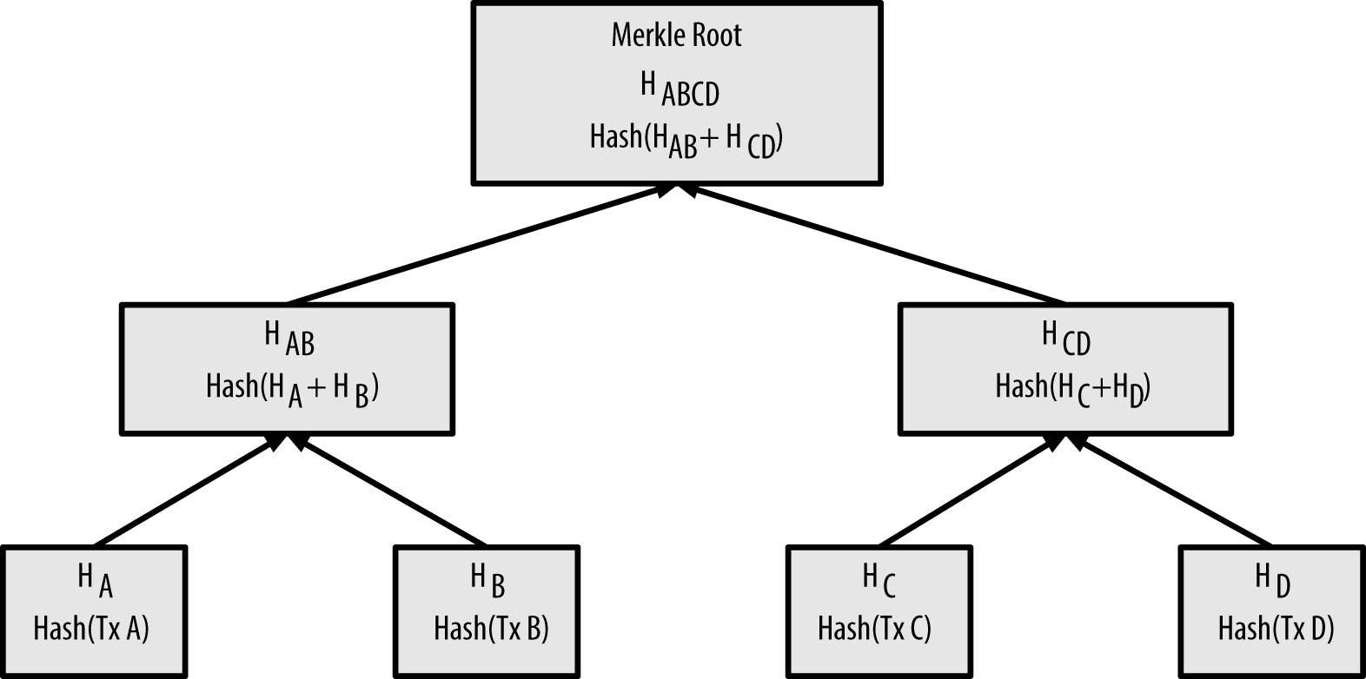
Replica synchronization
Merkle Tree

Slide 51
Handling Permanent Failures: Replica Synchronization
Anti-entropy protocol for replica synchronization
Use of Merkle tree for fast inconsistency detection and minimum transfer of data
Hash
non- leaf node
Hash values of the children
Hash
Hash
Hash
Hash
Hash
Hash
leaf node
Hash values of individual keys
D1
D2
D3
D4

Slide 52


Handling Permanent Failures: Merkle Tree
346738
346738
127839
784920
234829
684929
234829
684929
382921
482921
948272
472823
372829
948272
472823
372829
236382
236372
738292
236372
D3’’
D1
D2
D3’’
D1
D2
D3
D4
D3’
D4
Inconsistent
Data

Slide 53
Adding/Removing Storage Nodes
Node X will be added to the ring between A and B.
When X is added to the system, it is in charge of storing keys in the ranges
(F, G], (G, A] and (A, X].

Slide 54
Adding/Removing Storage Nodes
A gossip-based protocol propagates membership changes and maintains an eventually consistent view of membership.
Partitioning and placement information also propagates via the gossip-based protocol

Slide 55
Implementation
Java
Local persistence component allows for different storage engines to be plugged in:
Berkeley Database (BDB) Transactional Data Store: object of tens of kilobytes
MySQL: object of larger size
BDB Java Edition, etc.

Slide 56
Performance

Slide 57
Improvement
Each storage node maintains an object buffer in its main memory.
Each write operation is stored in the buffer and gets periodically written to storage by a writer thread.
Read operations first check if the requested key is present in the buffer

Slide 58
Improvement (Cont’d)
Lowering the 99.9th percentile latency by a factor of 5 during peak traffic

Slide 59
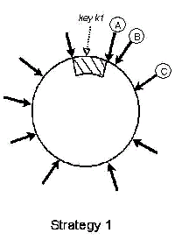
Evolution of Dynamo’s Partition Scheme
T random tokens per node and partition by token value:
Discussed in previous slides
Problems
data partitioning and data
placement are intertwined.

Slide 60
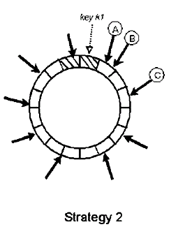
Evolution of Dynamo’s Partition Scheme
T random tokens per node and equal sized partitions:
Hash space is divided into Q equally sized partitions.
Advantages
Decoupling of partitioning and partition placement.

Slide 61
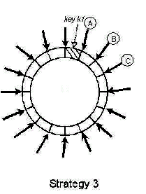
Evolution of Dynamo’s Partition Scheme
Q/S tokens per node, equal-sized partitions:
Hash space is divided into Q equally sized partitions.
each node is assigned Q/S tokens where S is the number of nodes in the system.

Slide 62
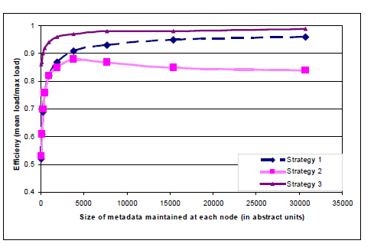
Comparing 3 Strategies
Strategy 3 achieves better performance because
Faster bootstrapping/recovery
Ease of archival

Slide 63
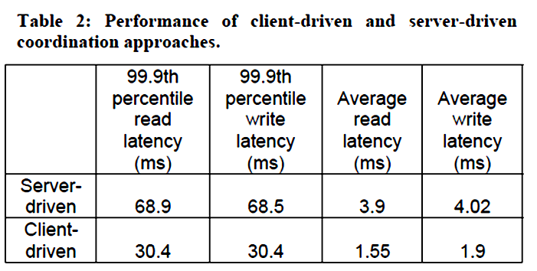
Coordination
Two ways:
Through a load balancer
Perform request coordination locally

Slide 64
Conclusion
Dynamo is a highly available, scalable and flexible data store for Amazon.com’s e-commerce platform.
Dynamo has been successful in handling server failures, data center failures and network partitions.

Slide 65
Reference
Decandia, G., Hastorun, D., Jampani, M., Kakulapati, G., Lakshman, A., Pilchin, A., Sivasubramanian, S., Vosshall, P., And Vogels, W. Dynamo: Amazon’s Highly Available Key-value Store. In Proceedings Of Twenty-first Acm Sigops Symposium On Operating Systems Principles (2007), Acm Press New York, Ny, Usa, Pp. 205–220.

Slide 66
THANK YOU

